Slide 1

DS Component Compliancy
Carrier POC

Slide 2

GOAL
Perform a component audit on the Carrier mobile application to determine design system compliancy in the following categories:
Icons
Colors
Typography
Components
Patterns
Accessibility
Branding Guidelines

Slide 3
GOAL
This audit will result in a compliancy score for each category. By completing this audit, we seek to:
Determine a baseline of compliance
Bring awareness
Jumpstart the conversation of how we get applications 100% design system compliant
Validate the POC Carrier audit so that this process can be repeated on other products

Slide 4

WHY DOES DS COMPLIANCY MATTER?
Design System Users
Creates consistency in the work being produced
Builds a framework for rapid response design & development
It ensures that the user experiences designed by UX carries over to the final user’s experience in products
Validates the transition from XD to Figma and elevates the value add of a design system team and its necessity

Slide 5
WHY DOES DS COMPLIANCY MATTER?
Products & End Users
Very simply put, it creates consistency in the users’ experiences
We are a Fortune 500 Company, and our users should expect a premium experience from our software

Slide 6

METHODS USED
The following methods were used to conduct this audit.
Code Audit
Design Audit

Slide 7

CODE AUDIT
Conducted by Jared Justus, Expert Software Engineer
Accomplished by documenting the known instances of components and comparing those instances with the number of components that were design system compliant.
Due to the amount of custom code being used in Carrier, the accuracy of the code audit is not as good as we would like, but still portrays an accurate story of design system compliance

Slide 8
ICON COUNT
Icon Instances
118
Compliant Instances
118
Icon Compliance
100%

Slide 9

COLOR THEME light vs dark
100%

Slide 10
TYPOGRAPHY COUNT
Text Instances
431
Compliant Instances
122
Text Compliance
28%

Slide 11
COMPONENT COUNT
Component Instances
1,048
Compliant Instances
142
Component Compliance
14%

Slide 12
COMPLIANCY LEVELS
4 components used 51 times
9 components used 594 times
15 components used 403 times
Notes:
Our density and multimodal service offerings not only mean we have the capacity to move your freight, but we can also move it in the most efficient manner possible
https://www.jbhunt.com/blog/2022/06/capacity-to-deliver

Slide 13
HIGHEST USED COMPONENTS
Component | Known Instances | Compliant Instances | Usage | Component Compliance
Button | 379 | 39 | 36.16% | 10.29%
Toast | 126 | 0 | 12.02% | 0%
Card | 89 | 16 | 8.49% | 17.98%
Modal | 68 | 0 | 6.48 | 0%
Total | 662 | 55 | 63.16% | 7.07%

Slide 14

DESIGN AUDIT
Conducted by Mark Young, Senior UX Designer
Accomplished by creating a custom ‘Audit Theme’ that was applied to a special design system library. This audit theme was then passed into a test version of Carrier.
Anything you see on screen using the traditional J.B. Hunt color theme is not design system compliant.
Design system compliant components should appear in black, white, or magenta.

Slide 15
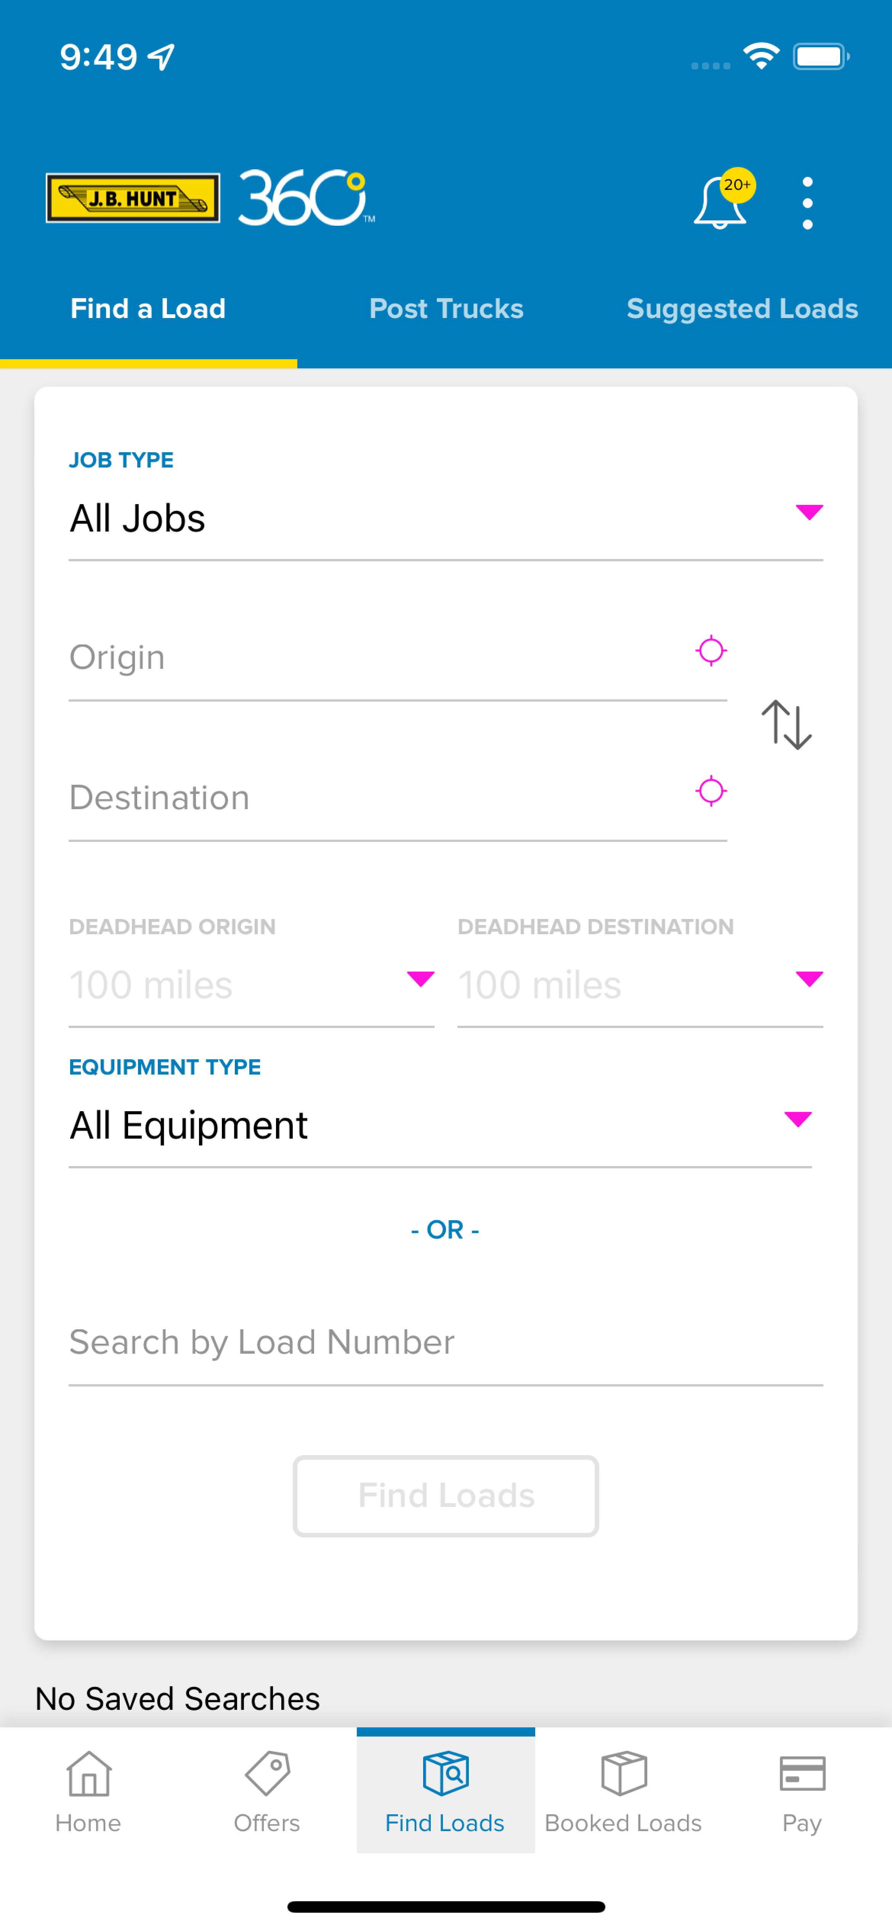
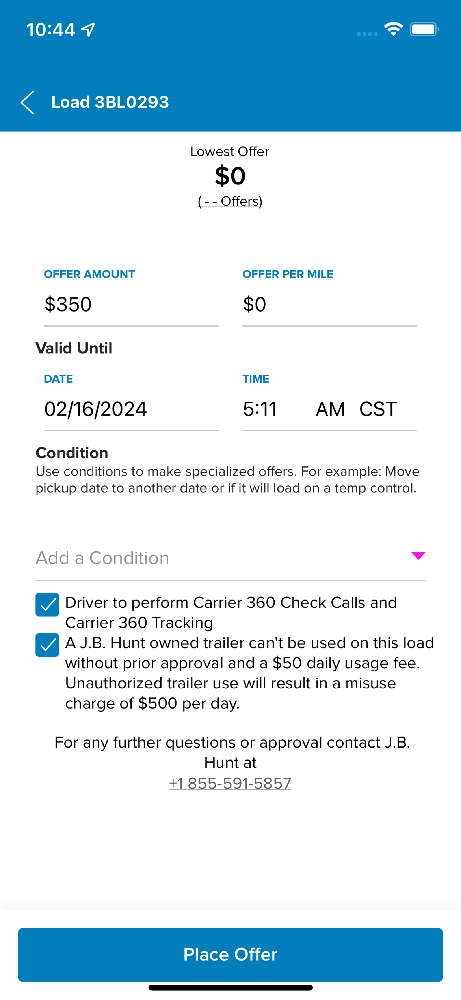
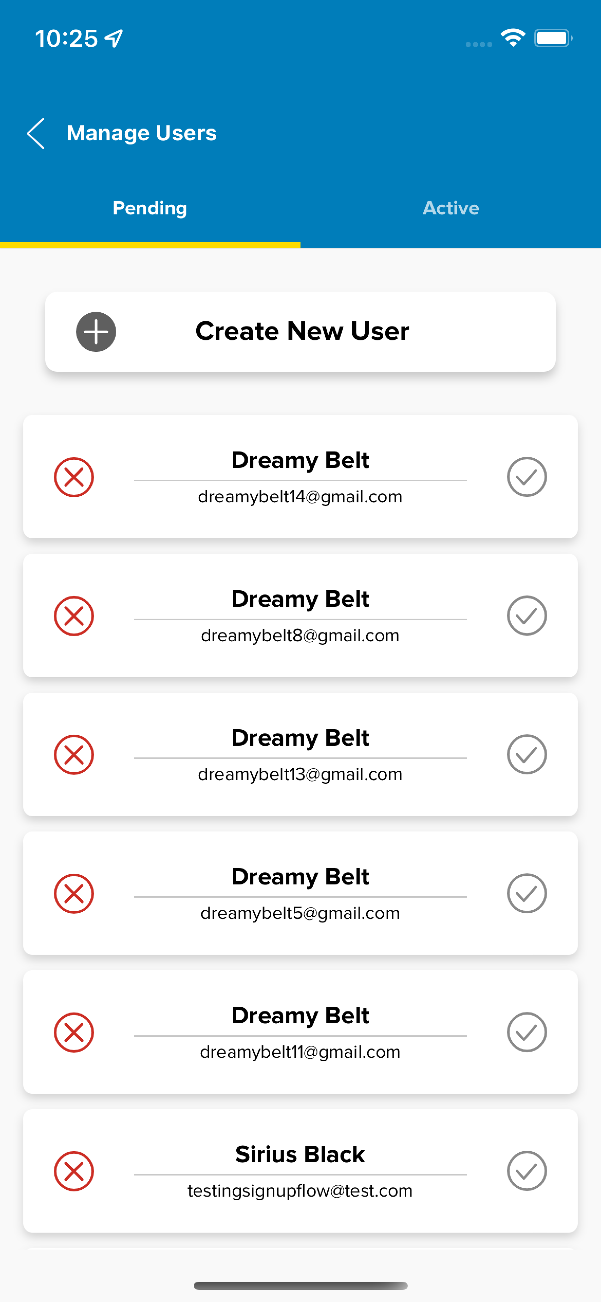
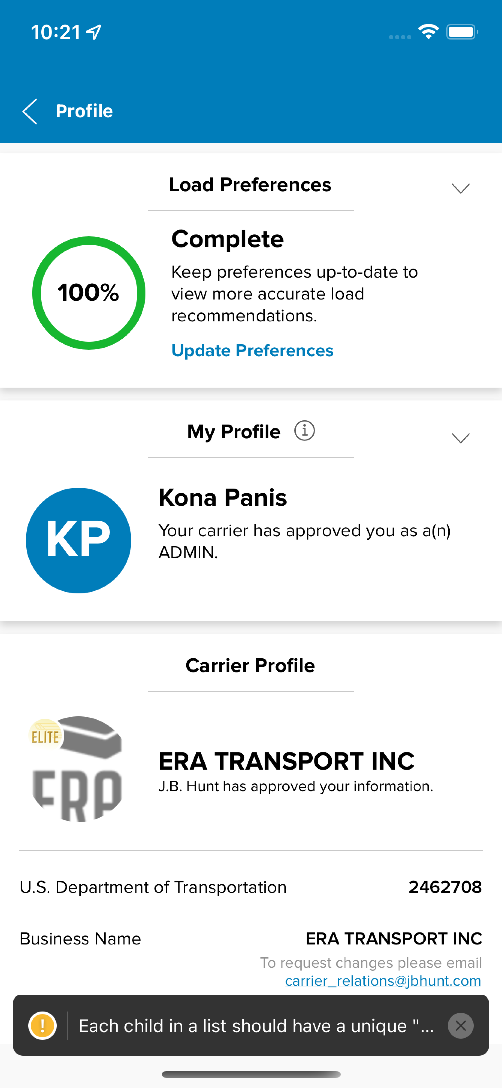
NON-COMPLIANT EXPERIENCES

Slide 16
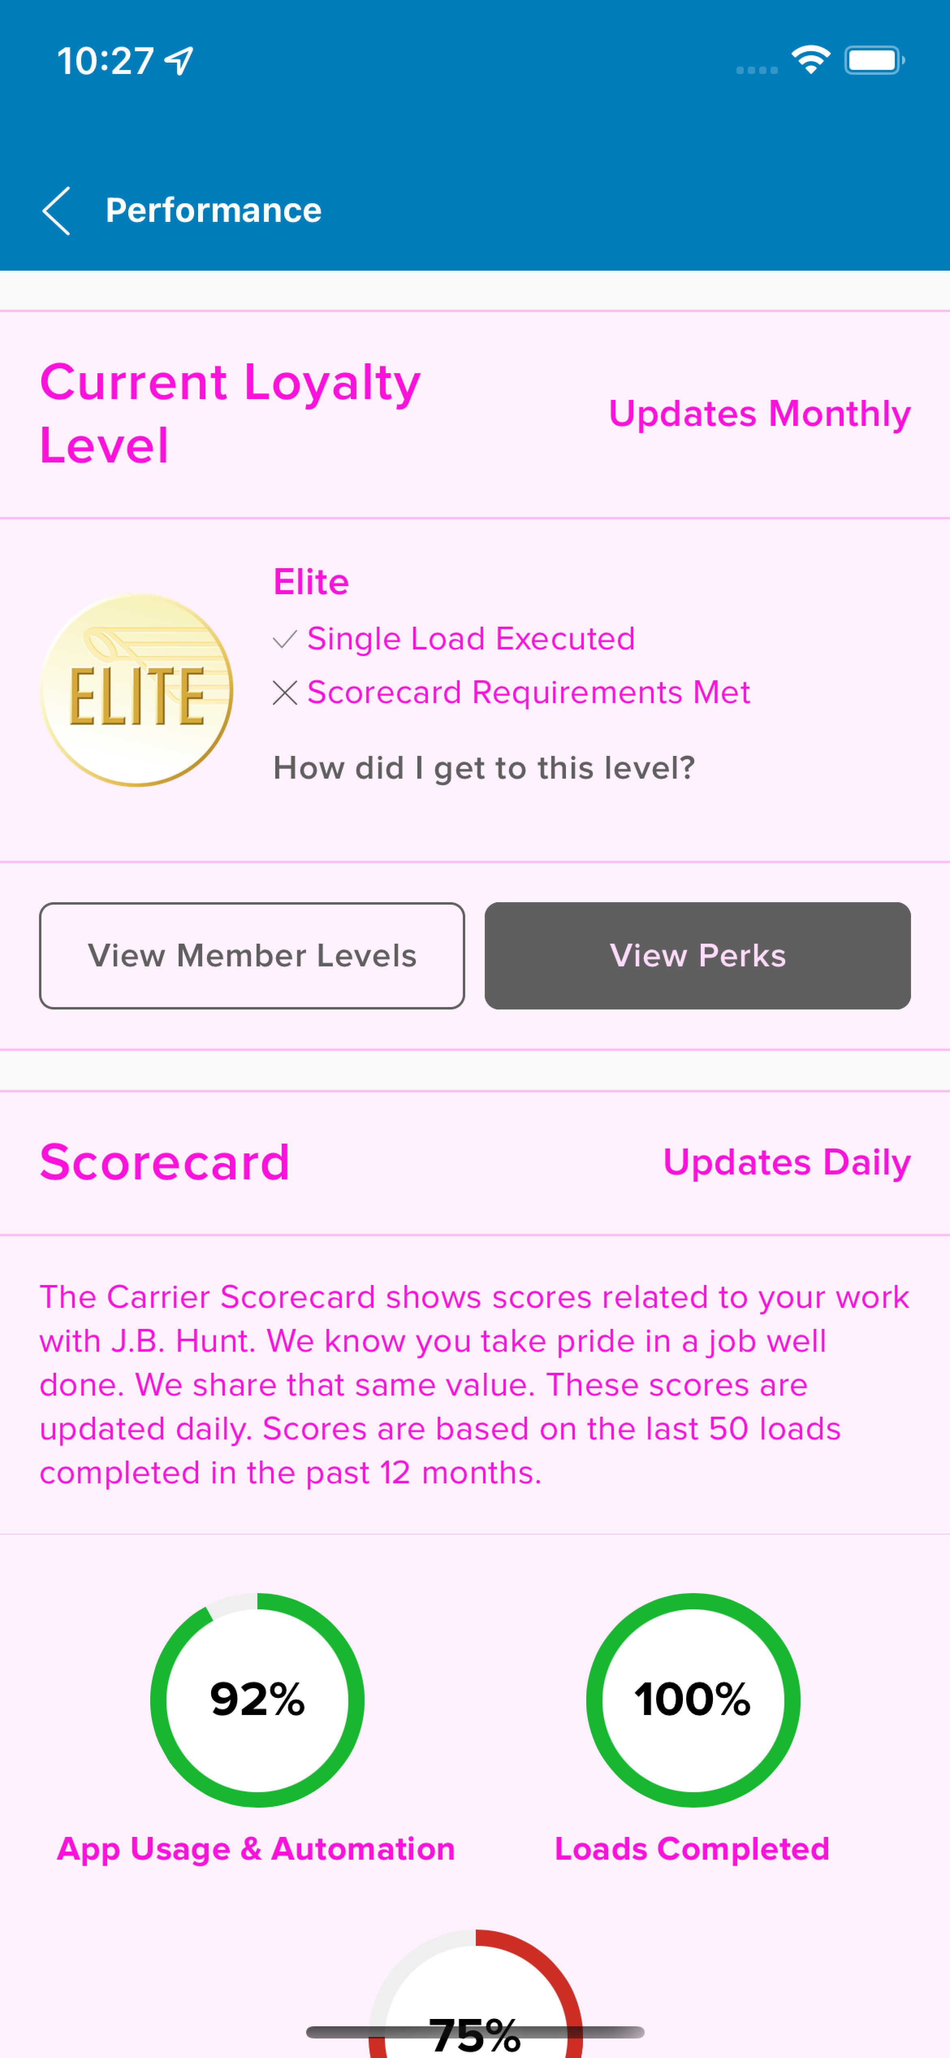
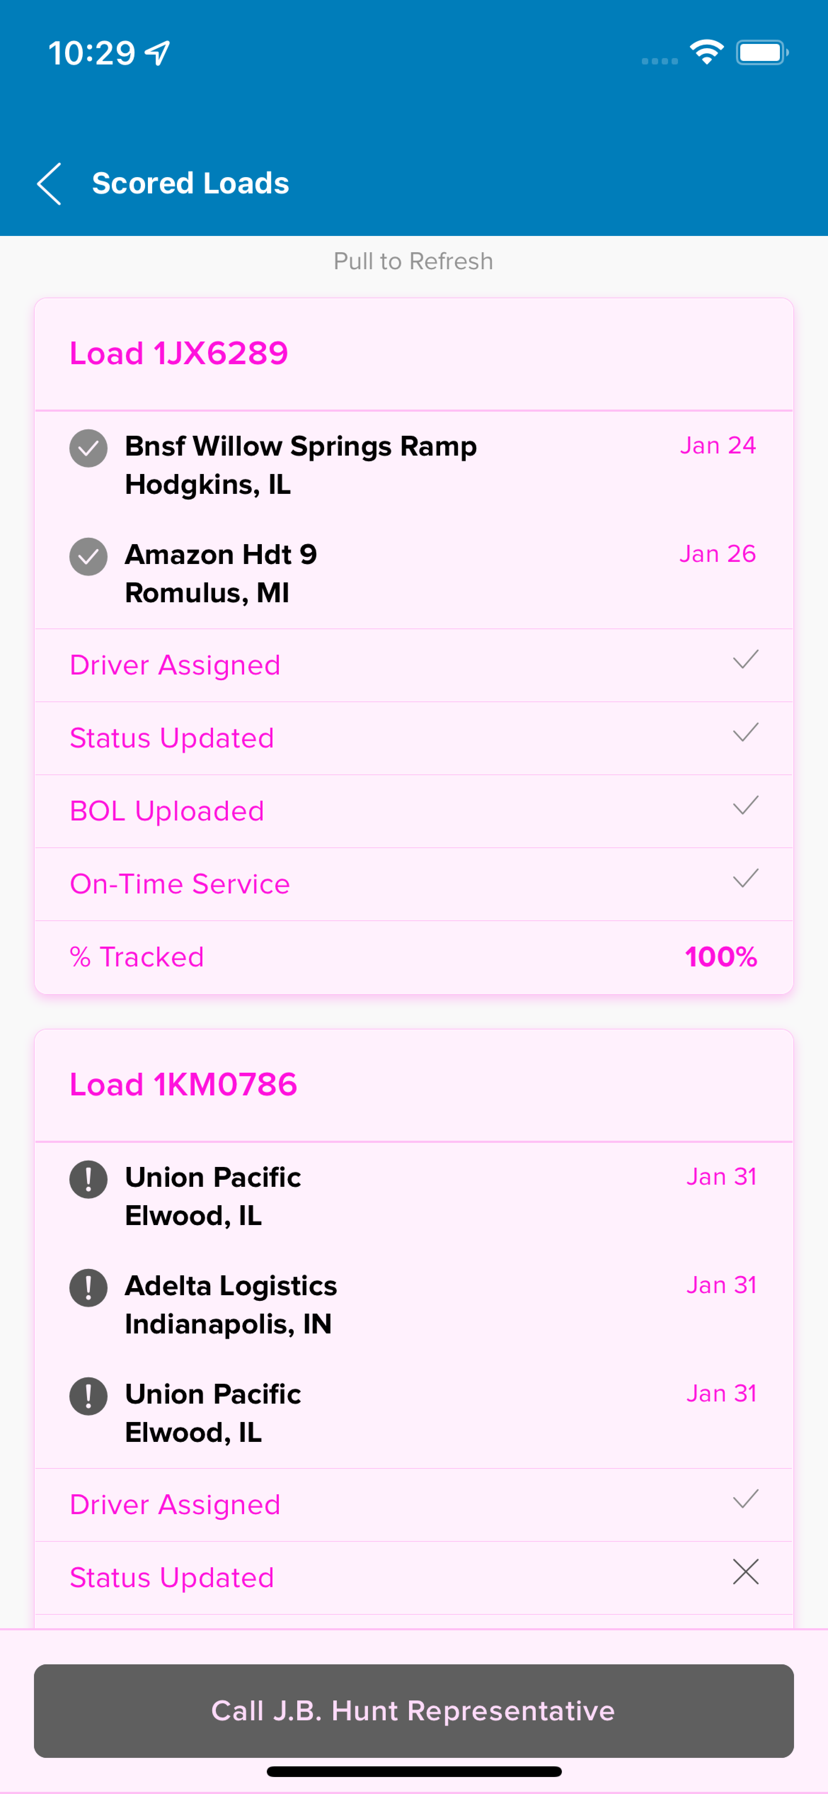
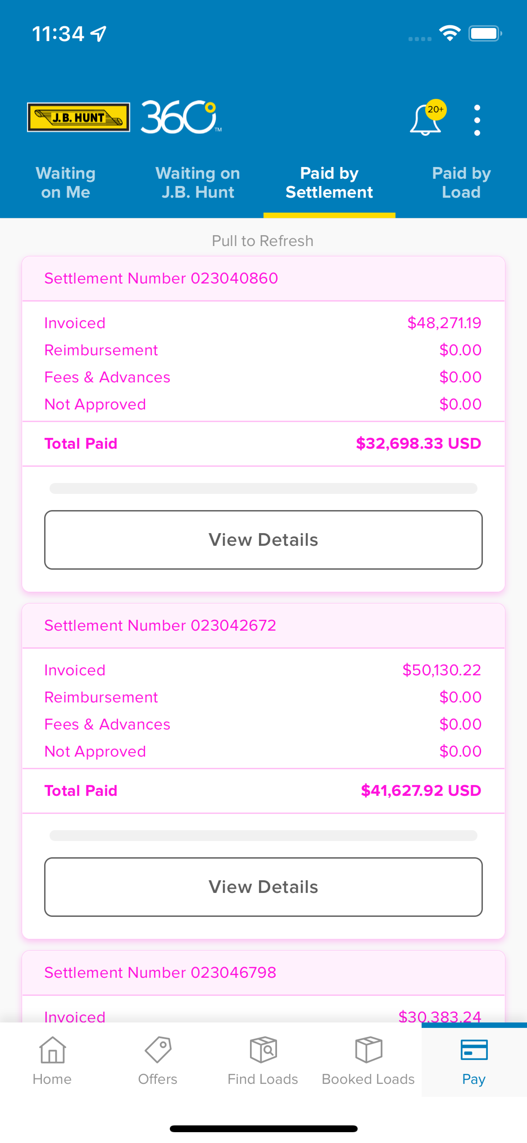
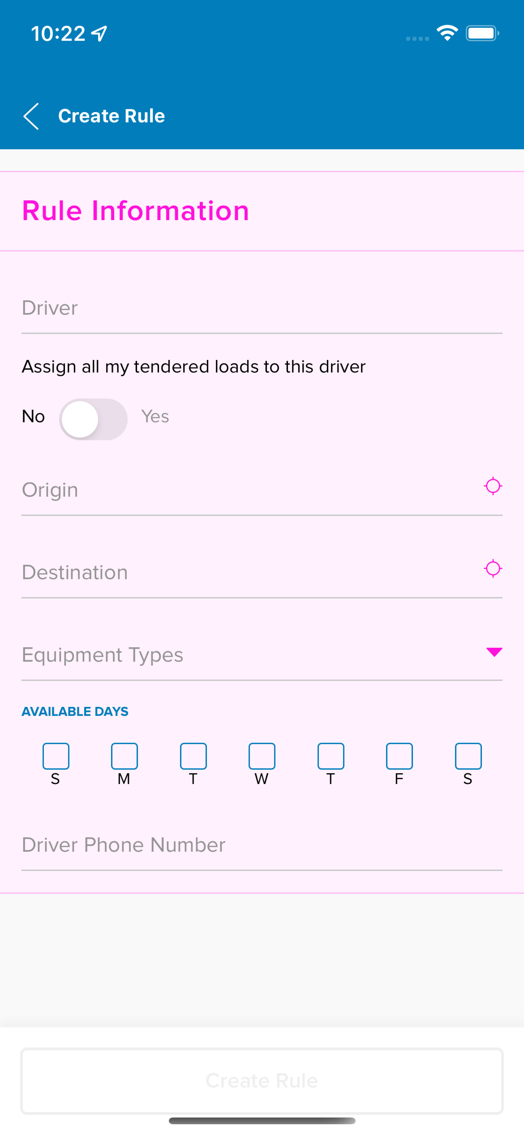
SOMEWHAT-COMPLIANT EXPERIENCES

Slide 17

CONCLUSION
Carrier is not at the level of design system compliancy we would like.
This is being passed on to the end users’ experience.
We need to face the reality that a problem exist so we can address it.
The average app loses 77% of DAU’s (daily active users) after just three days…
Although Carrier is a SaaS, we are not impervious to this statistic. Carrier’s users have other options.
The average monthly churn rate for SaaS companies is 3-8% which would mean the average retention rate should be in the 92-97% range.

Slide 18

CONCLUSION
For every dollar being spent on the mobile design system team to support Carrier, $0.14 is being used and $0.86 is vanishing and never used.
This creates an impossible situation for the design system team to show its value when the work we do is never seen by the business or the end users
It’s my opinion that over time this situation will make the switch from XD to Figma seem completely unwarranted

Slide 19
RECOMMENDATIONS
Bring awareness to the right stakeholders and let’s start seeing things for how they are
We’re going to have to work with the business to see how we can best address this.
This needs to be approached in a way that isn’t ”The Design System VS Product Teams”
Meet with product teams to determine what the cause or holdback on component implementation is. This will help the DS Team understand how we can best support product teams.

Slide 20
Questions?

